Slide 1


Slide 2
What is Spring Boot.
Spring Boot is a project that is built on the top of the Spring Framework. It provides an easier and faster way to set up, configure, and run both simple and web-based applications.
It is a Spring module that provides the RAD (Rapid Application Development) feature to the Spring Framework. It is used to create a stand-alone Spring-based application that you can just run because it needs minimal Spring configuration.
For web application, spring boot automatically installs the tomcat. User need not install tomcat on their system.
For db applications, Spring boot installs online database. User need not install any database like MySQL etc.,
Spring boot provides the environment for faster development.

Slide 3
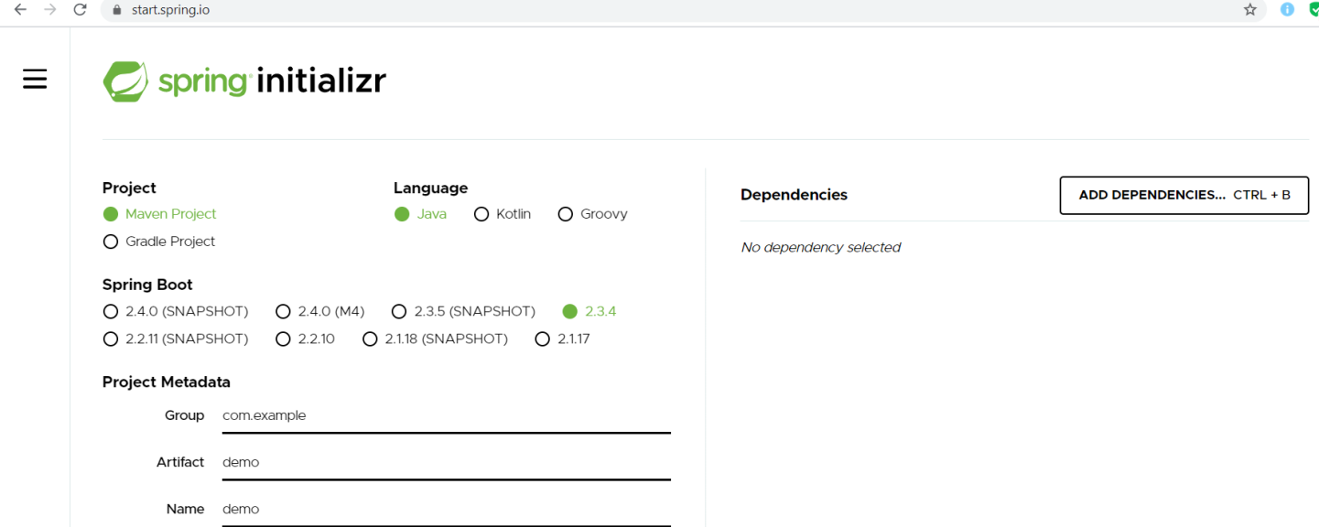
Spring initializr
Open the link start.spring.io in the web and it will allow you to generate the maven project along with the dependencies.

Slide 4
First spring web boot application.
Demo MyFirstBootProjectWebProject in c:\java\spring workspace.
Select the dependencies as spring web and spring dev tools and generate the code.
Extract it in eclipse as file → import → Maven → Existing maven project → Select the pom file and click on finish.
Open pom.xml and check the dependencies.
Open main java file and run the file.
Change the server port in application.properties as
server.port=8091
Create a controller under the same directory of the main applicatoin file but under a directory of controller and type the following code.
  @RestController
    public class myController {
    @RequestMapping ("/test")
    public String testFuntion ()
    {
    String str = "This is my first spring boot web application...";
    System.out.println ("This is seen in console..");
    return str;}}
And Modify the main java application code as
    @SpringBootApplication
    @ComponentScan (basePackages= {"com.sunsoft.MyFirstBootProjectWebProject.controller"})
    public class MyFirstBootProjectWebProjectApplication {
    public static void main(String[] args) {
    SpringApplication.run(MyFirstBootProjectWebProjectApplication.class, args);}}

Slide 5
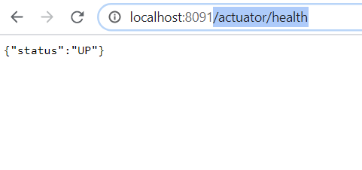
Spring boot Actuator
Actuator will give the health of the system.
In the Spring initializr (start.spring.io), select spring boot actuator.
Generate the project and check in pom.xml about this dependency. This would have added spring-boot-starter-actuator in the dependency.
And run the project with /actuator/health in the url.

Slide 6
Database operation with Spring boot.
My Reference : Project is in c:\java\spring1 workspace.
With start.spring.io, choose the dependencies as spring data jpa, spring web, MYSQL Driver and developer tools and generate the project.
Import the same in eclipse with pom.xml of this project.
Verify the pom.xml with what is selected in dependencies in start.spring.io.

Slide 7
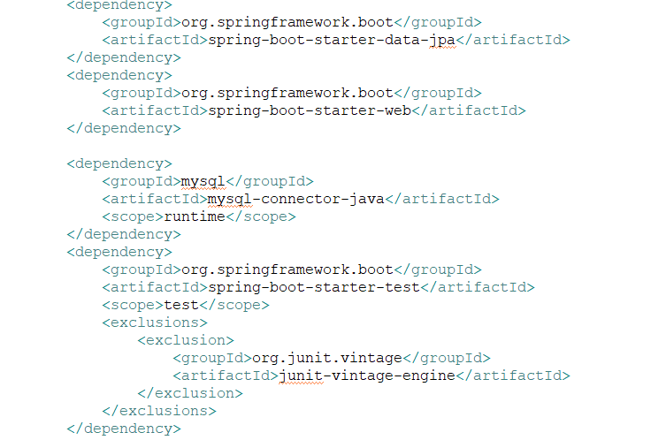
Pom.xml

Slide 8
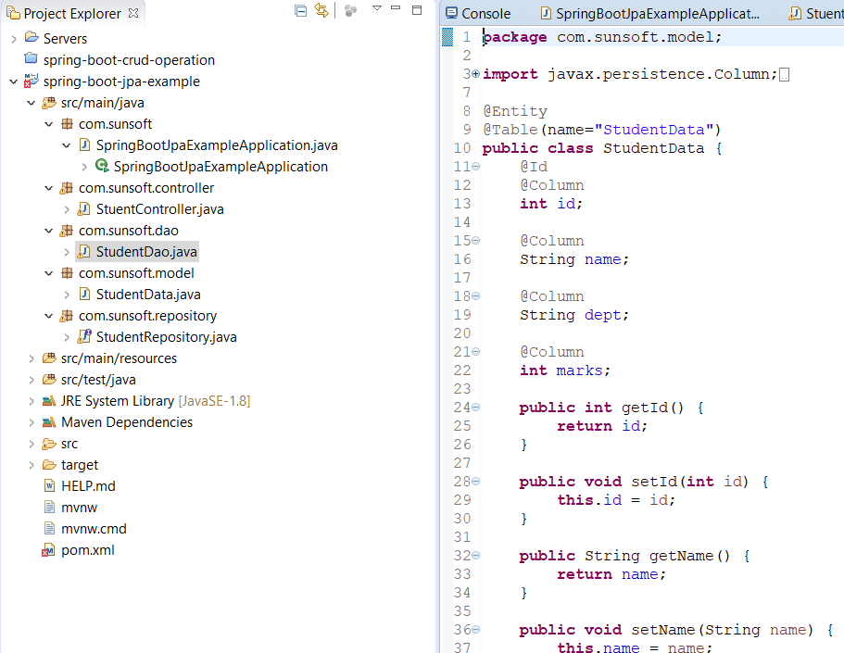
Create the model or bean file.

Slide 9
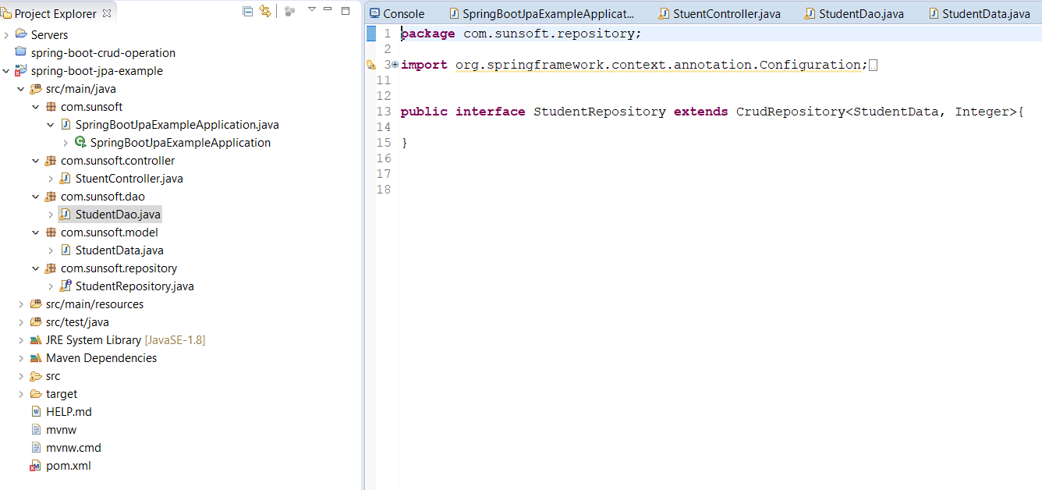

Create a repository.

Slide 10
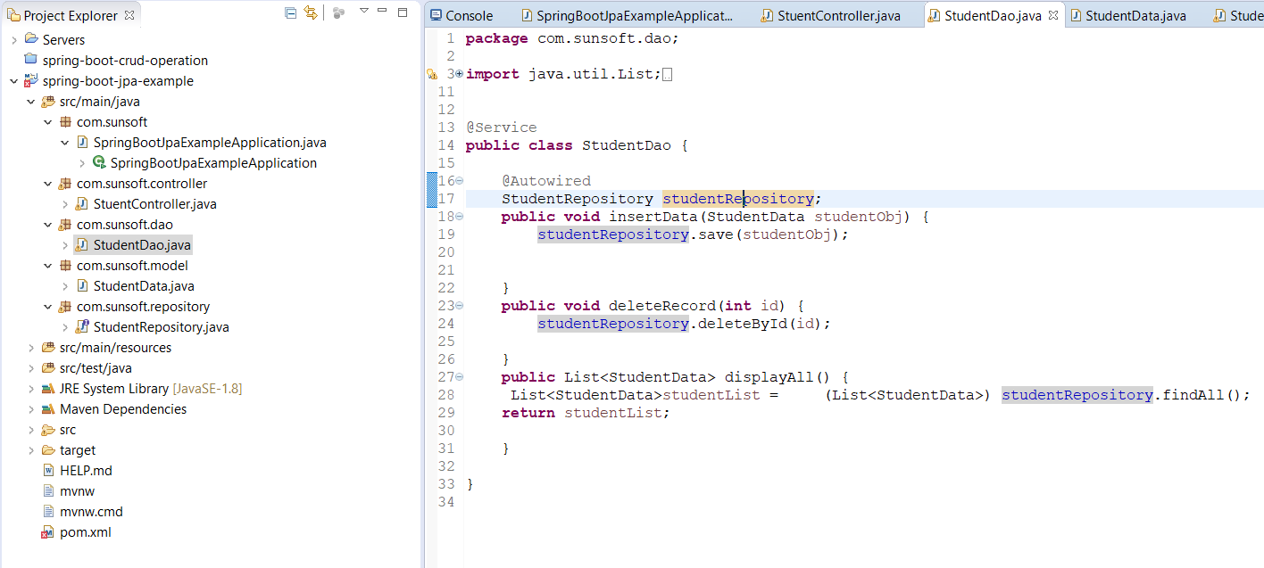
DAO file.

Slide 11
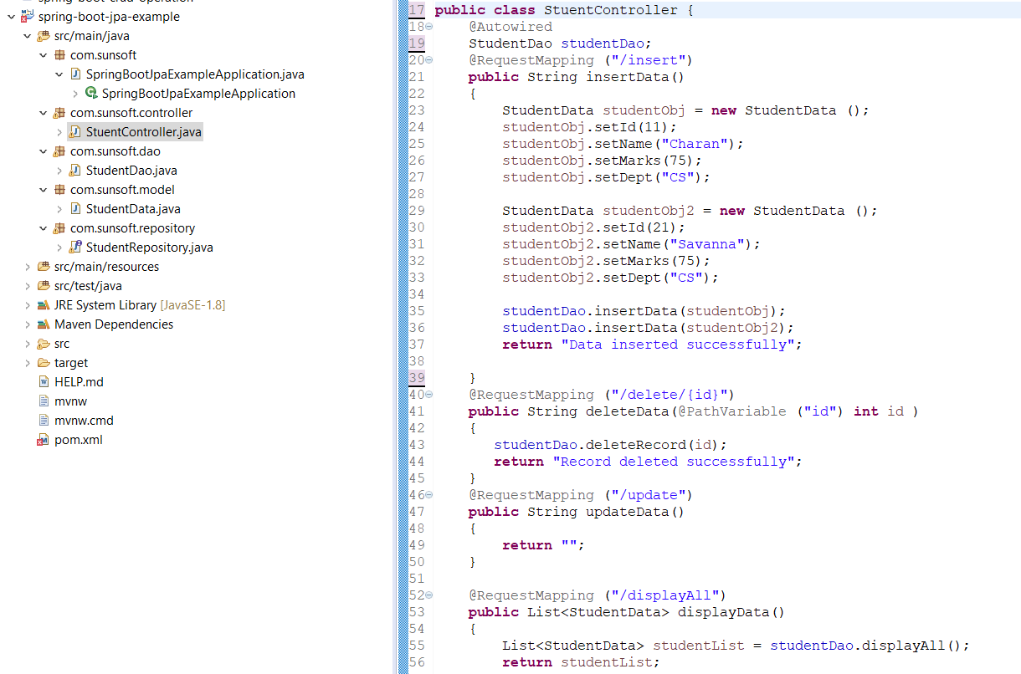
Controller

Slide 12
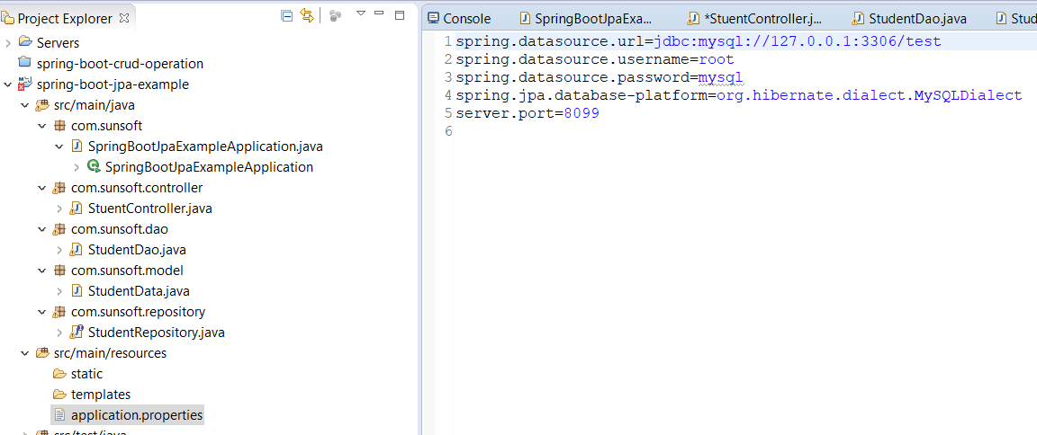
Application.properties

Slide 13
Explanation about this project.
In Application.properties, specify the database properties.
In pom.xml verify what the dependencies are given are present or not.
In the bean file, create a pojo with getter and setter methods.
Repository is the one which holds the link with the database table. Here it is StudentData.
DAO class uses this repository to perform the db operations. Save(), Update, findbyid() methods are used to perform db operations.

Slide 14
Explanation about this project.
In Controller, provide all the links and the corresponding functionalities to be invoked. DAO object is autowired (Dependency Injection) in the controller file. Using this object, functions are dao are calling. In DAO, repository object is autowired and db operation methods are invoked.

Slide 15
Thank you!!

